Slide 1
Specific New diagnostic Implement Pointing at Echinococcosis
T
Recombinase polymerase amplification
TOC
Background
Description
Design
AND Sys & OR Sys
RPA: PRC-like Amplification
Colloidal Gold Assay
Model
Resources
CSU_CHINA 2022😺
贺靖 2/6/2023

Slide 2
# ​Background
棘球蚴病(Echinococcosis) 也称包虫病(hydatid disease)，是一种人畜共患的寄生虫病🤧
主要影响人类的两种棘球蚴病类型🔍
囊型棘球蚴病 (Cystic Echinococcosis, CE) /囊型包虫病
泡球蚴病 (Aveolar Echinococcosis, AE) /泡型包虫病
人类通常由摄入存在于食物/水体/土壤中的寄生虫卵，或直接接触动物宿主后感染☣

Slide 3
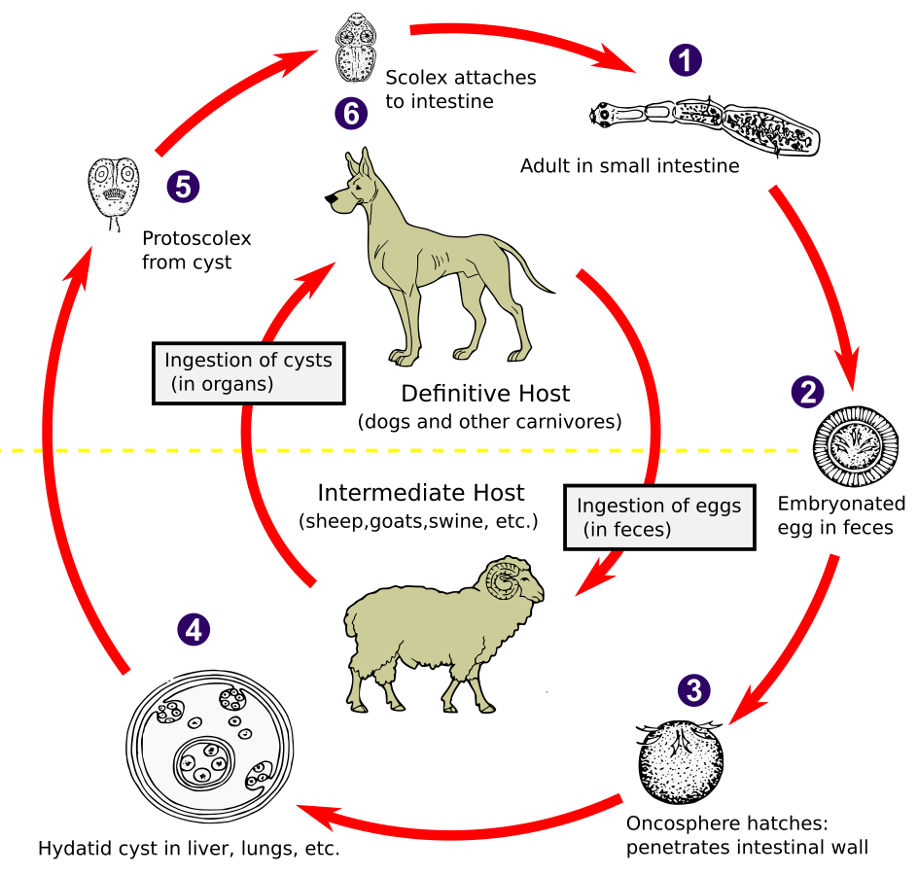
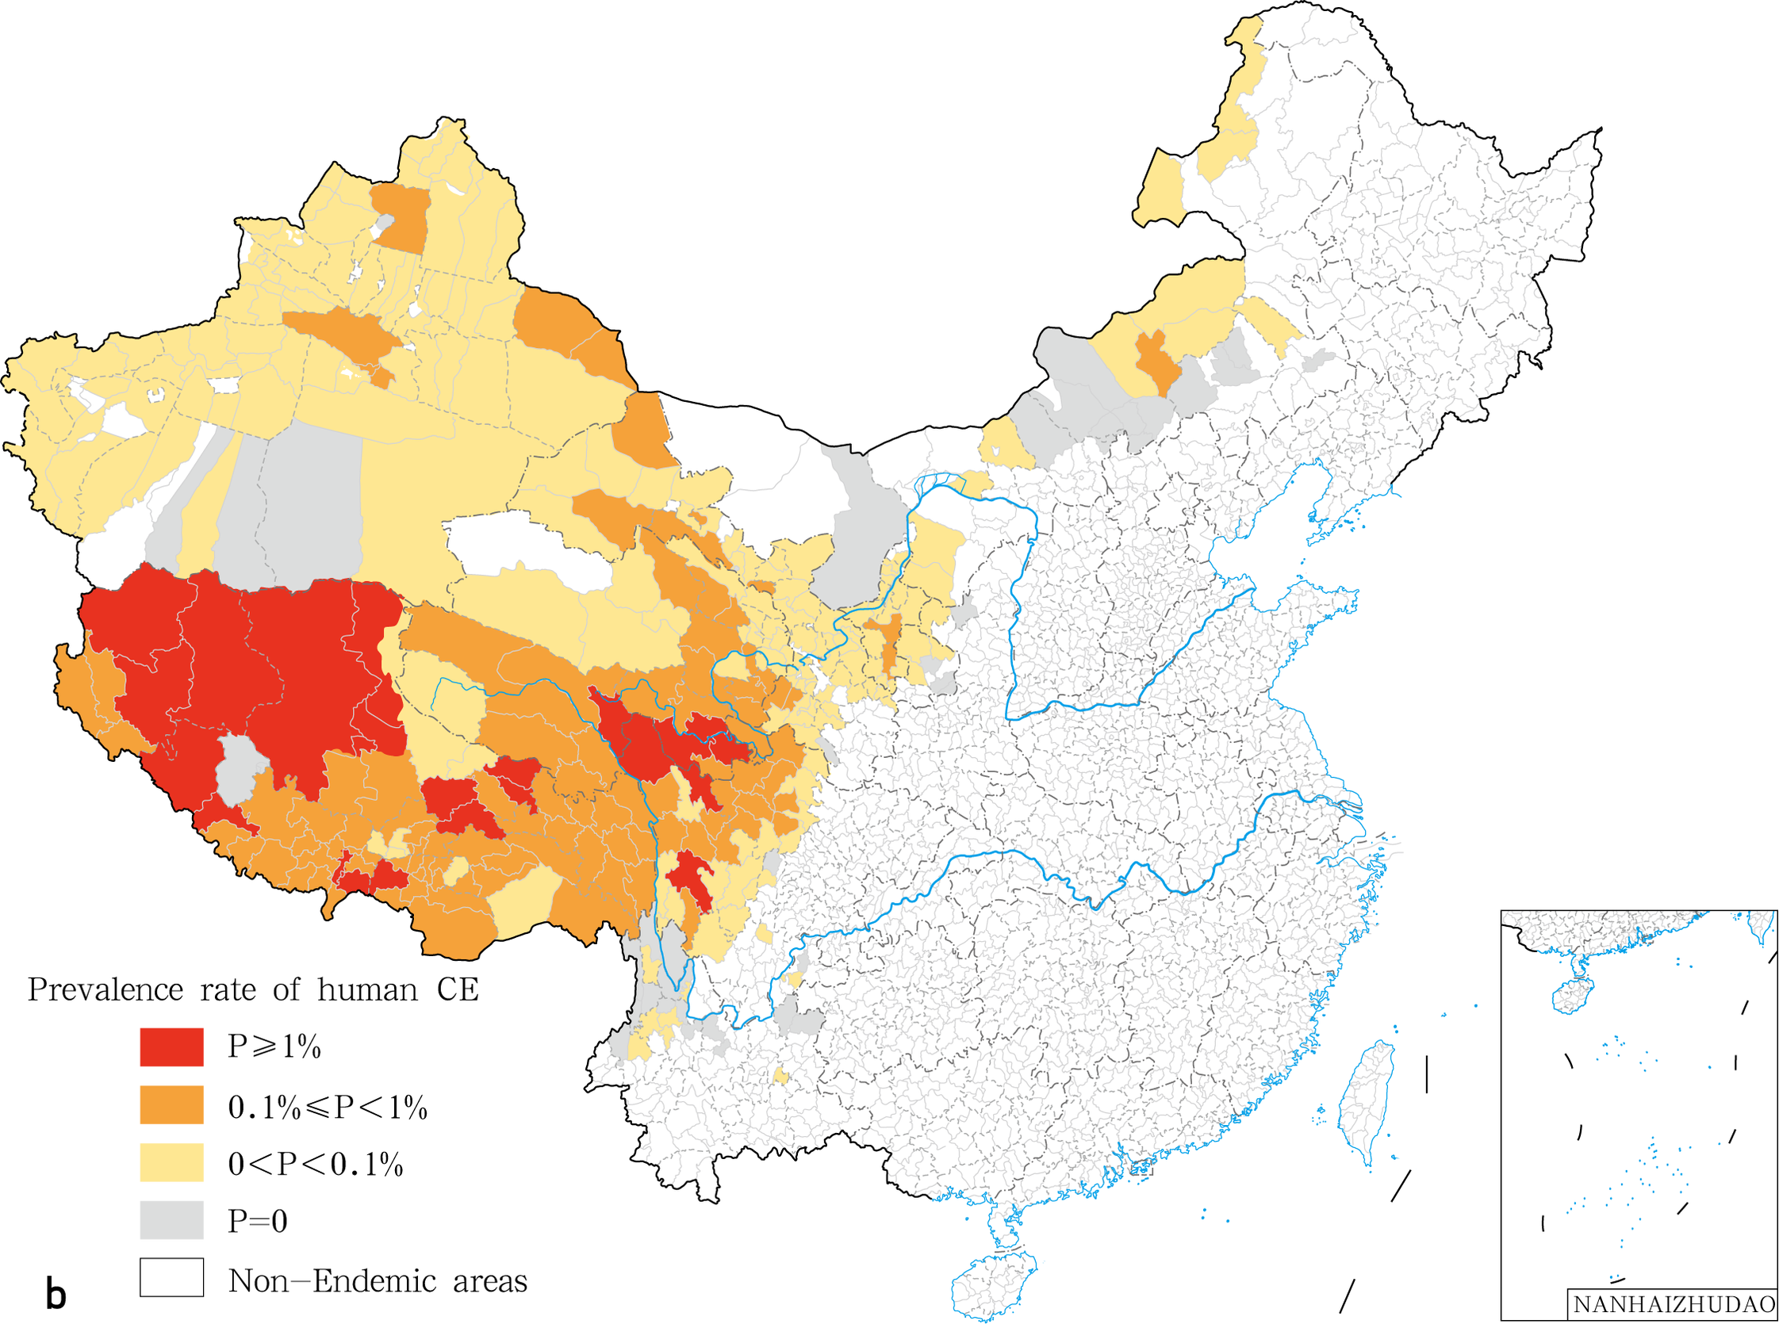
# ​Background
[A] 细粒棘球绦虫的生命周期
[B] 2018年中国囊型包虫病的空间分布

Slide 4
# ​Background
棘球蚴病的疗程通常昂贵且治疗复杂，常伴随着长期的手术和药物干预😥
超声波成像(Ultrasound imaging) 是诊断棘球蚴病的常用技术，然而传统技术通常在疾病晚期才检测到感染🔬
目前暂时没有准确/早期/非侵入性的分子诊断方法🧬
Optimizing the diagnostic method of echinoccosis💪

Slide 5
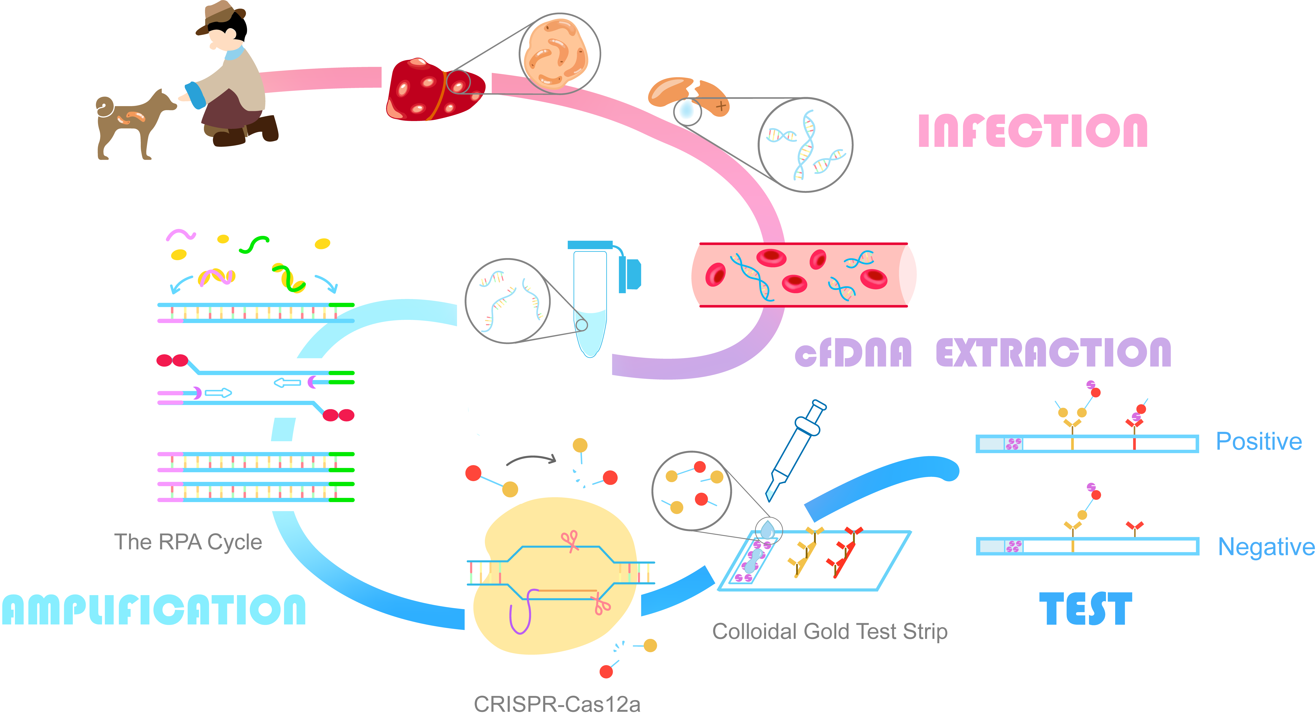
# ​Description
Use RPA and CRISPR-csa12a to amplify and detect the genome of echinococcosis
cfDNA (cell free DNA)

Slide 6
# ​Description

Slide 7
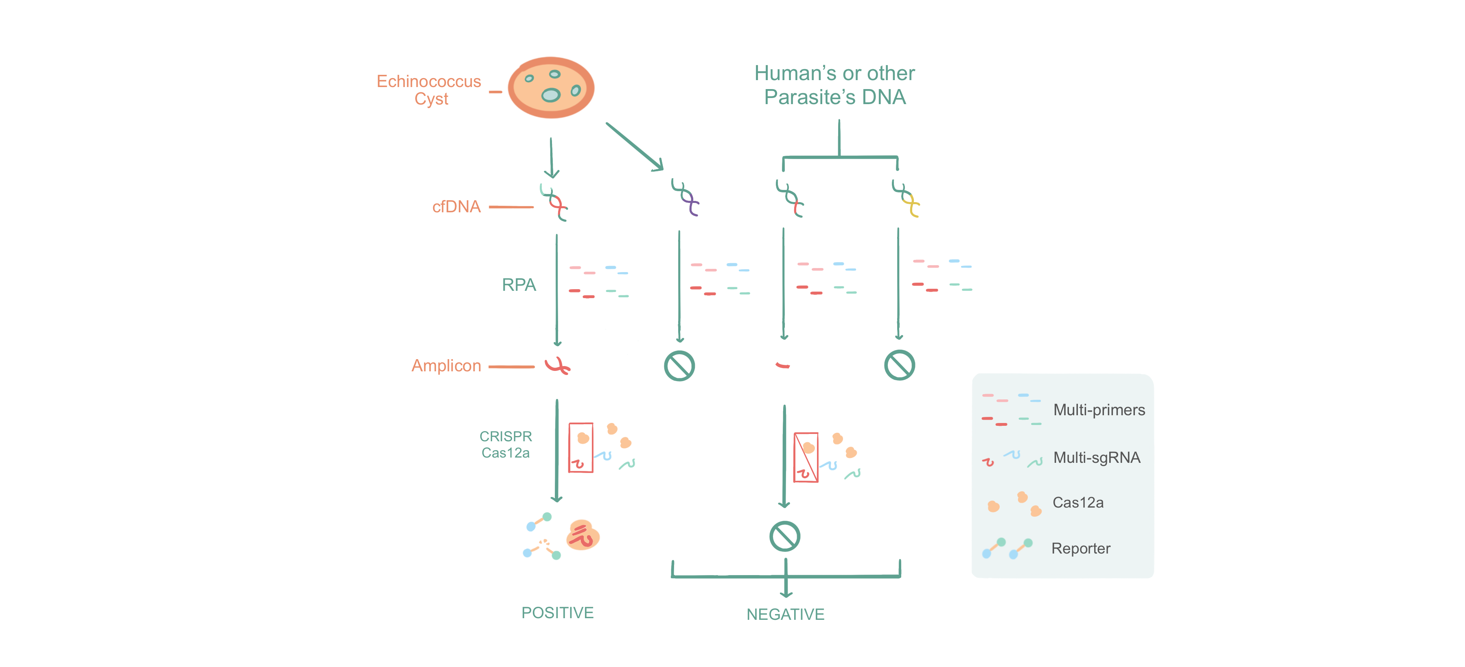
# ​Design
T
Recombinase polymerase amplification
[A] AND SYSTEM

Slide 8
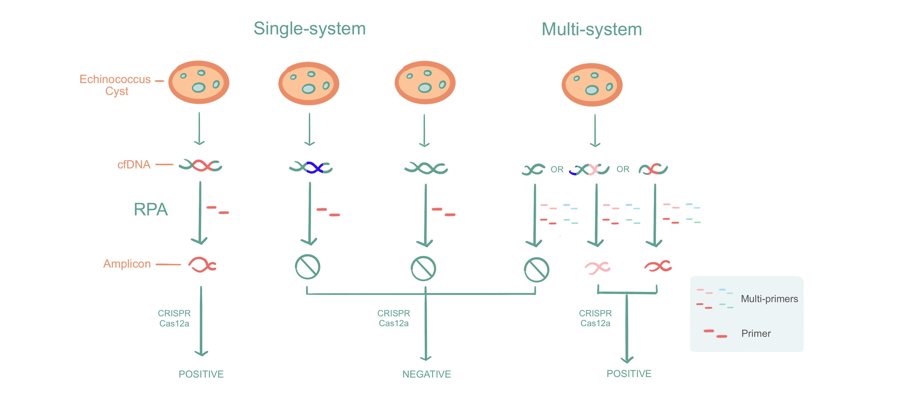
# ​Design
T
Recombinase polymerase amplification
[B] OR SYSTEM

Slide 9
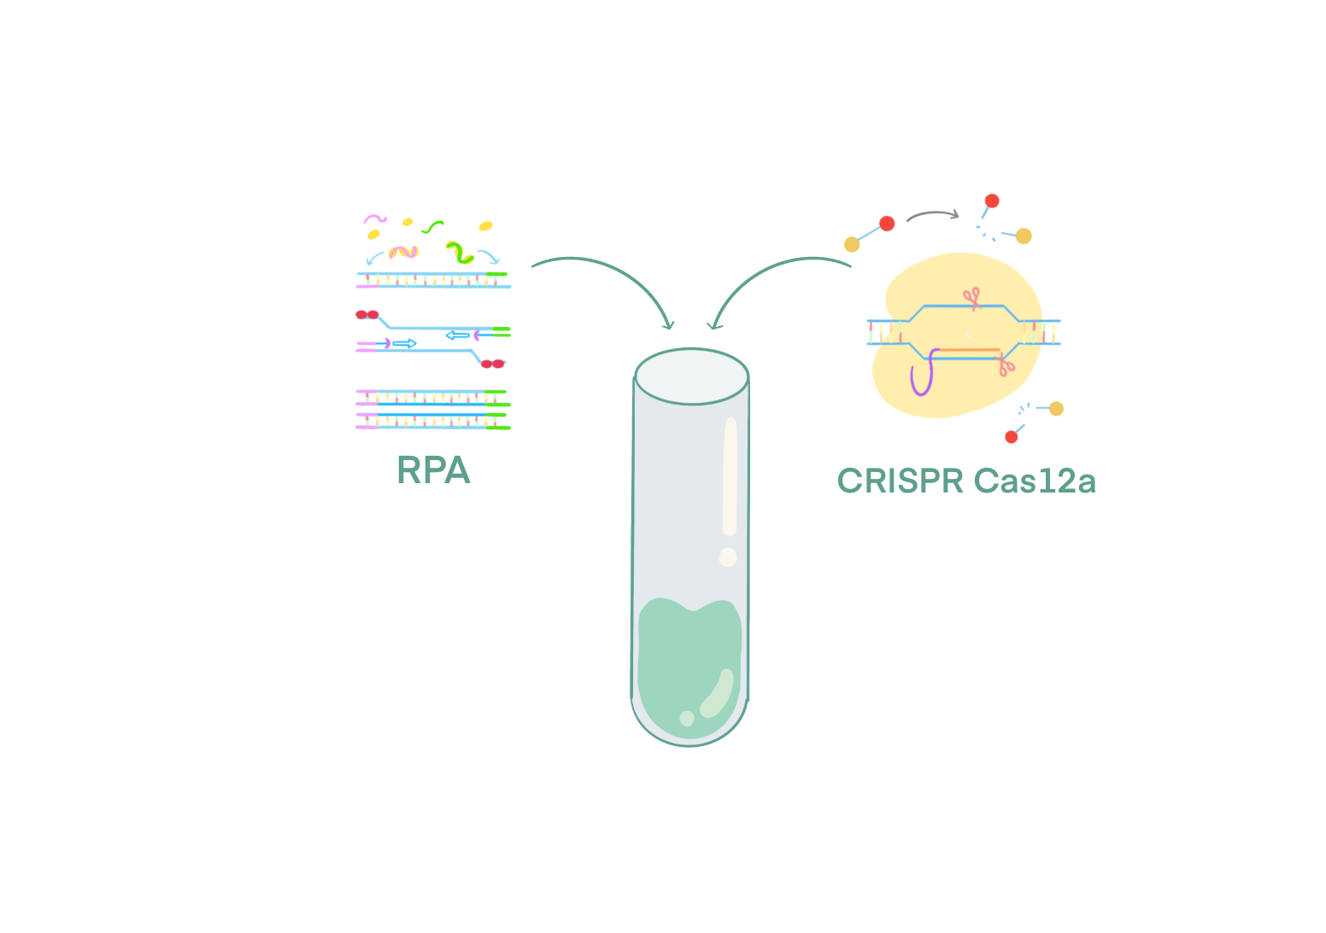
# ​Description
Recombinase polymerase amplification (RPA) ⚗
PCR 技术的单管恒温替代方案
Three core enzymes
Recombinase
Single-stranded DNA-binding protein (SSB)
Strand-displacing polymerase

Slide 10
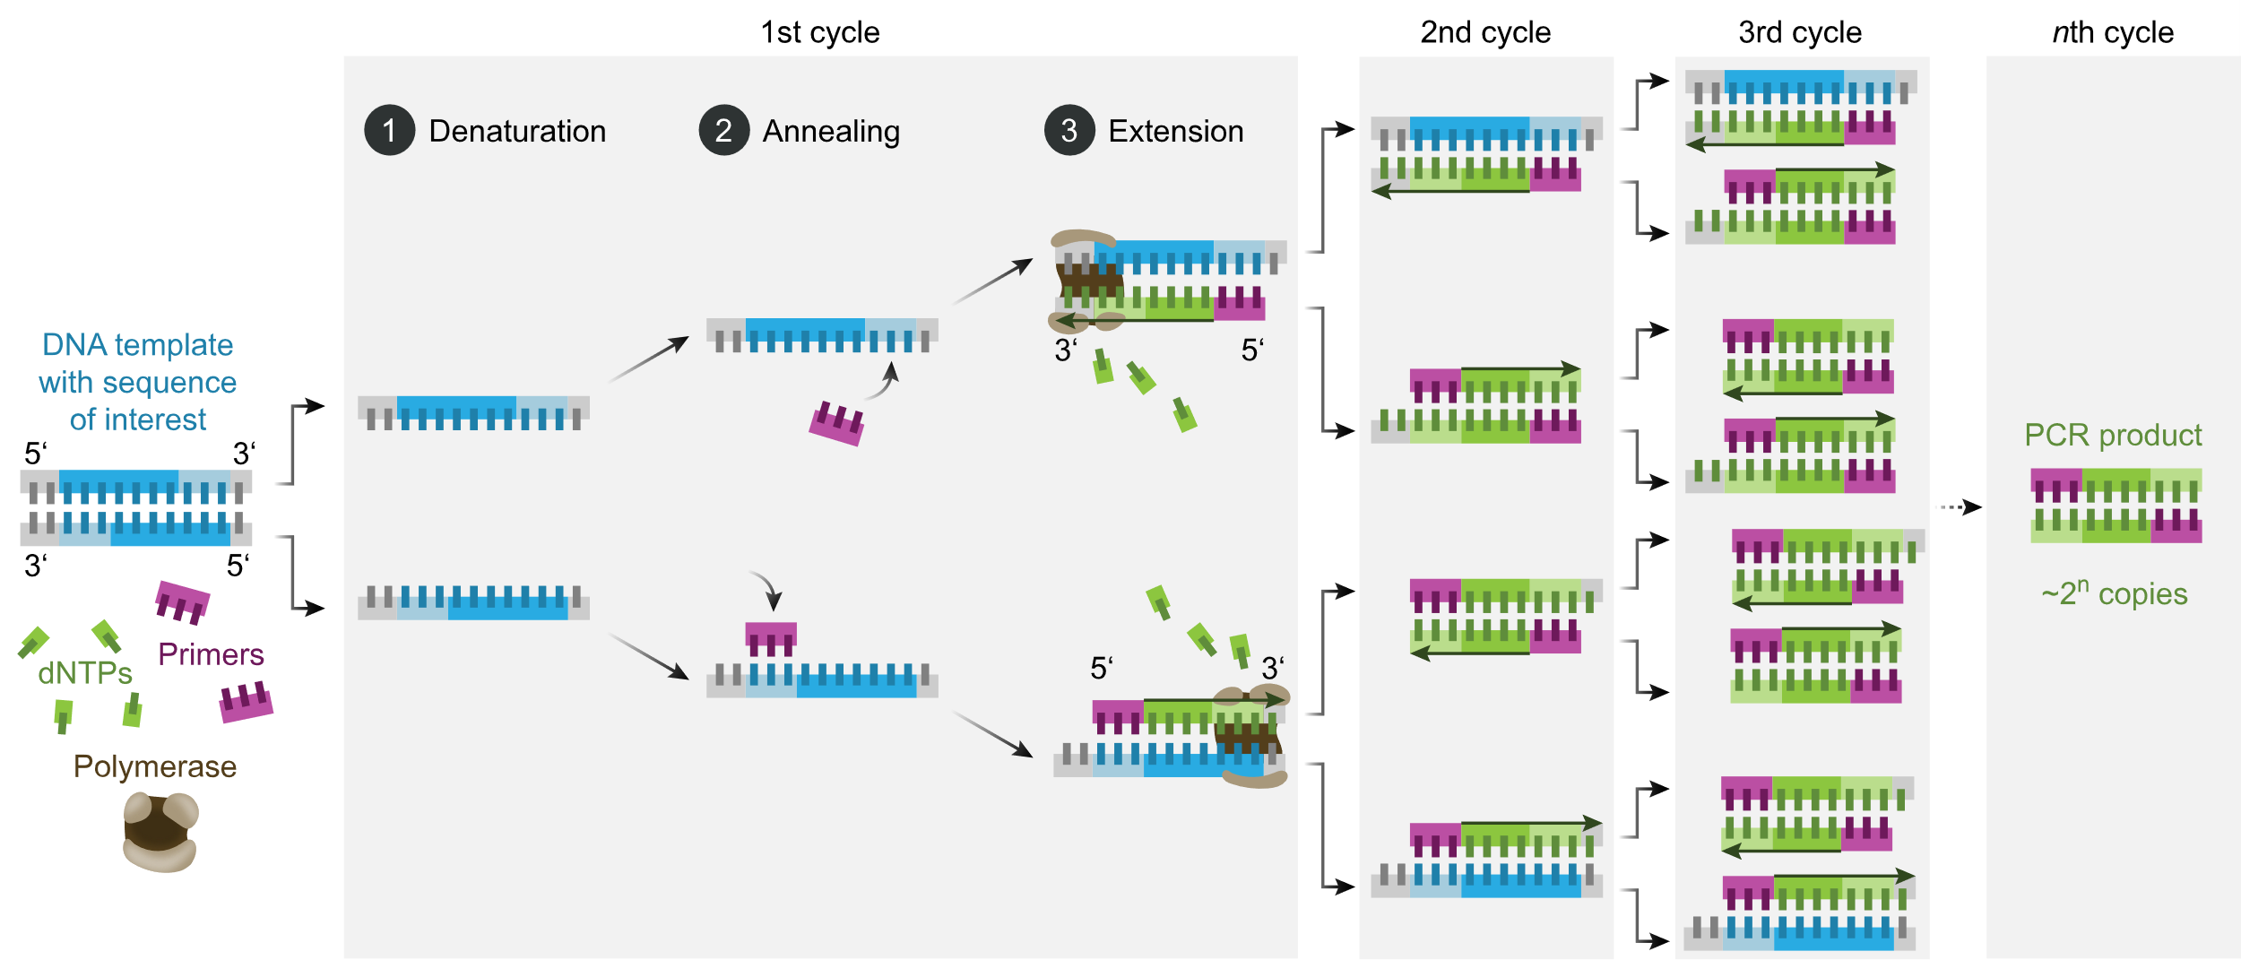
The PCR Cycle

Slide 11
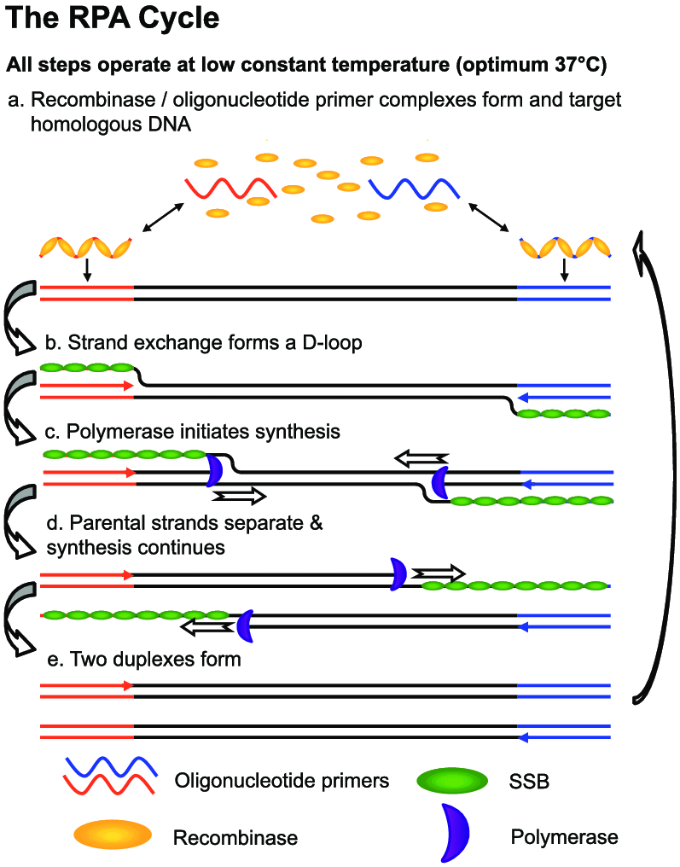
T
Recombinase polymerase amplification
👉重组酶-寡核苷酸引物复合体同时也充当了目标片段的探针作用
T
Recombinase polymerase amplification

Slide 12
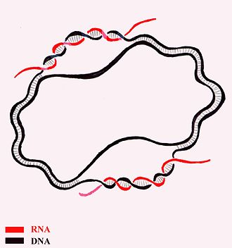
T
Recombinase polymerase amplification
D-loop
(Displacement loop）
图示 DNA 转录情形
T
Recombinase polymerase amplification

Slide 13
T
Recombinase polymerase amplification
👉三种关键蛋白酶可实现类 PCR 的 DNA 扩增，无需 thermal /chemical melting 即可初始化扩增
T
Recombinase polymerase amplification

Slide 14
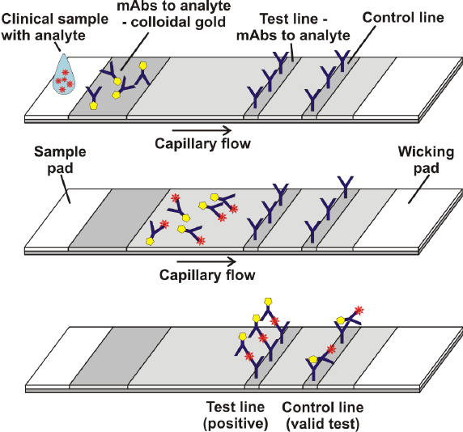
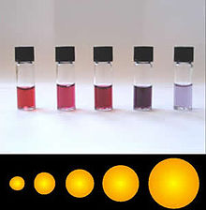
Colloidal Gold Assay
👆
各种尺寸的金纳米颗粒悬浮液，大小差异会导致颜色差异。

Slide 15
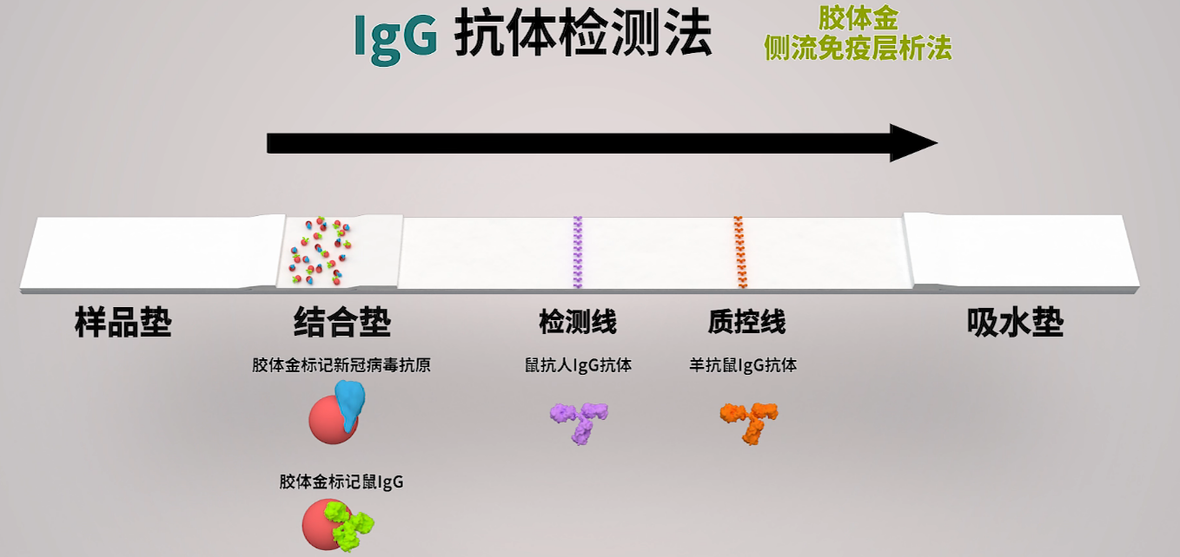
Colloidal Gold Assay

Slide 16
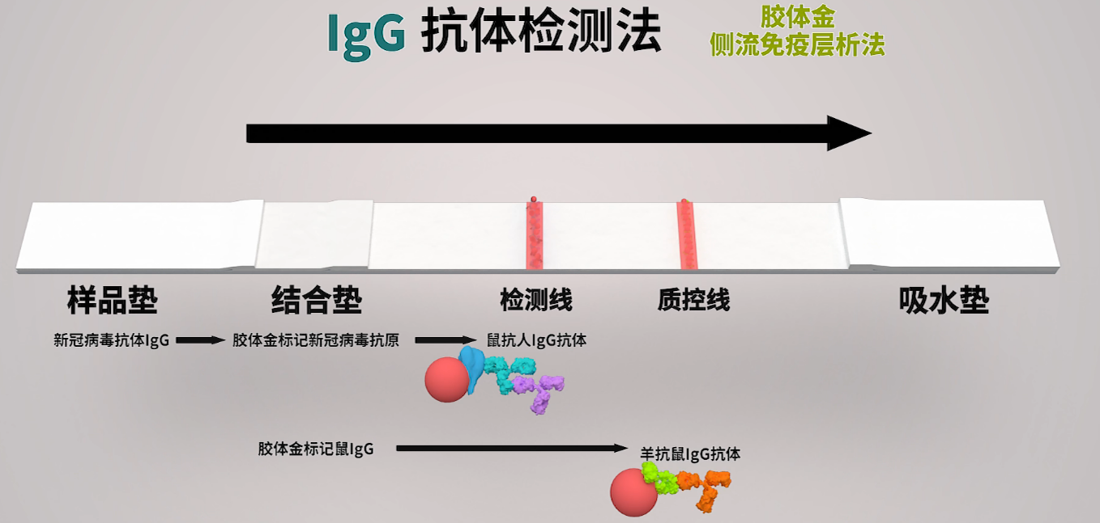
Colloidal Gold Assay

Slide 17
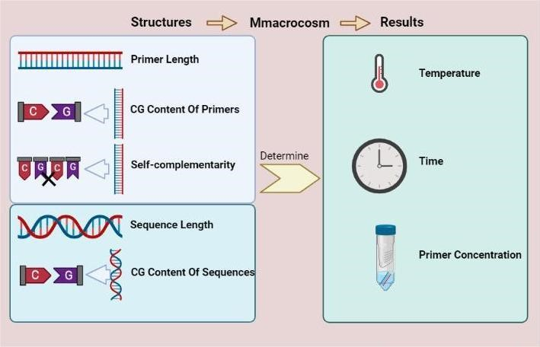
# ​Model

Slide 18
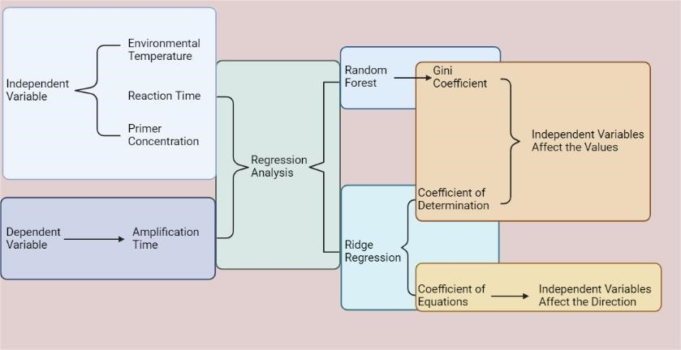
# ​Model

Slide 19
# ​Resources
https://2022.igem.wiki/csu-china/index.html
https://en.wikipedia.org/wiki/Echinococcosis
https://en.wikipedia.org/wiki/Colloidal_gold
https://www.who.int/news-room/fact-sheets/detail/echinococcosis
Daher, R. K., Stewart, G., Boissinot, M., & Bergeron, M. G. 2016 “Recombinase Polymerase Amplification for Diagnostic Applications”. Clinical chemistry, 62(7), 947–958.

Slide 20


